Slide 1
Which beach in Chicago is best for the family?

Slide 2


Slide 3
Beach_E_coli_Predictions.csv
Beach_Swim_Advisories.csv
Beach_Water_Quality.csv
Beach_Weather_Stations.csv

Slide 4
Data analysis of the following:
Turbidity
Wind
Temperature
E. Coli

Slide 5
Which Lake has the cloudiest water?
Secchi Disk

Slide 6
Turbidity of Water. What is it? Cloudiness of the water caused by:
Clay and Silt. Mainly erosion.
Algae

Slide 7
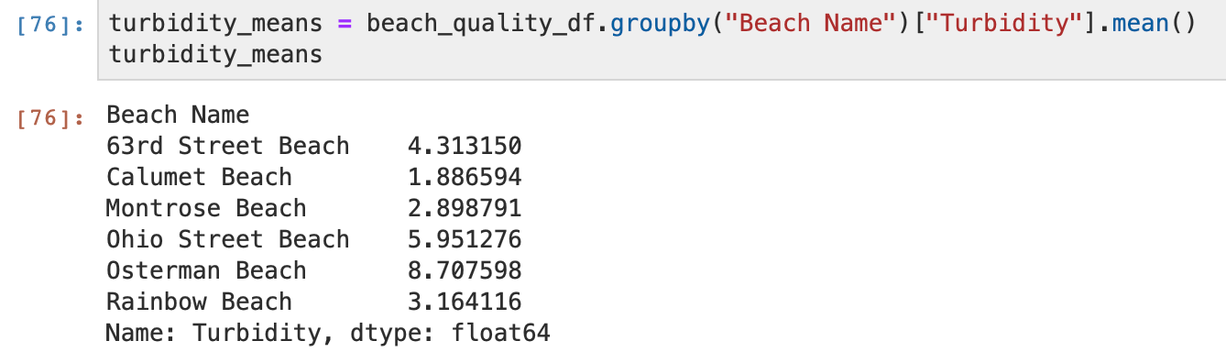

Slide 8
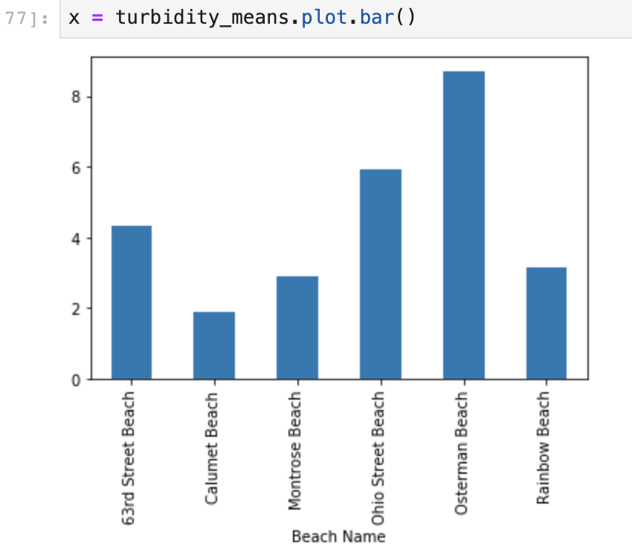

Slide 9
Which Beach has the warmest water?

Slide 10
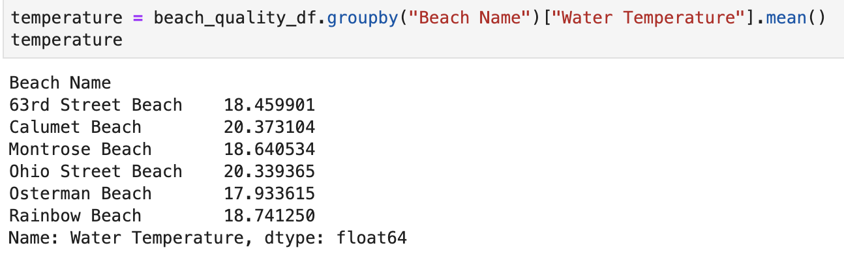

Slide 11
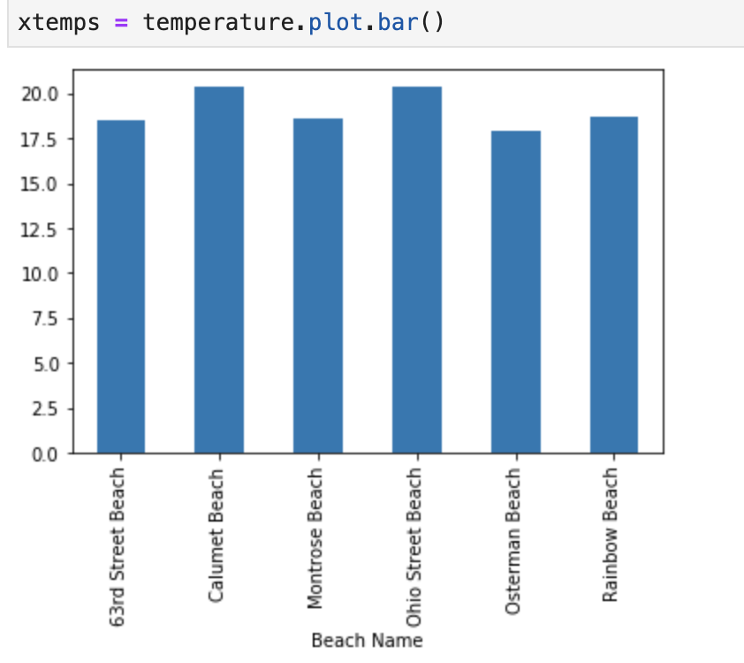

Slide 12
Which beach has the highest waves?

Slide 13
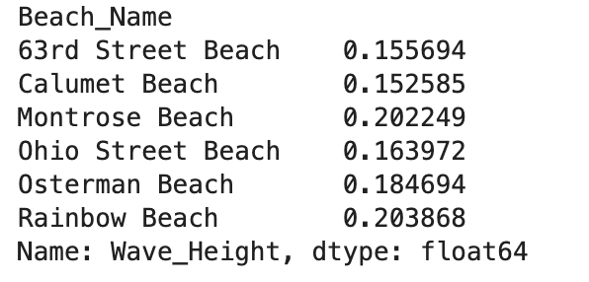

Slide 14
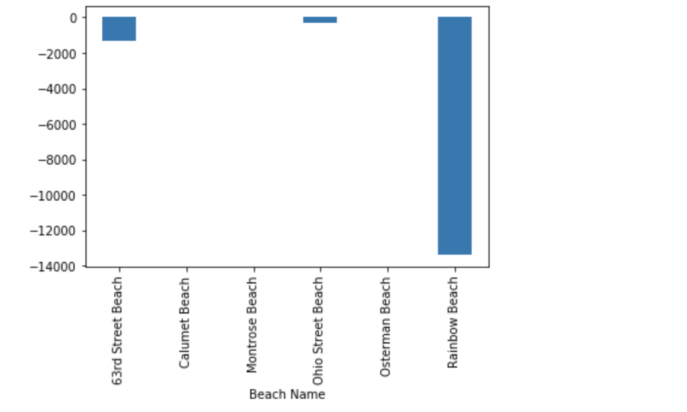
Data munging example

Slide 15
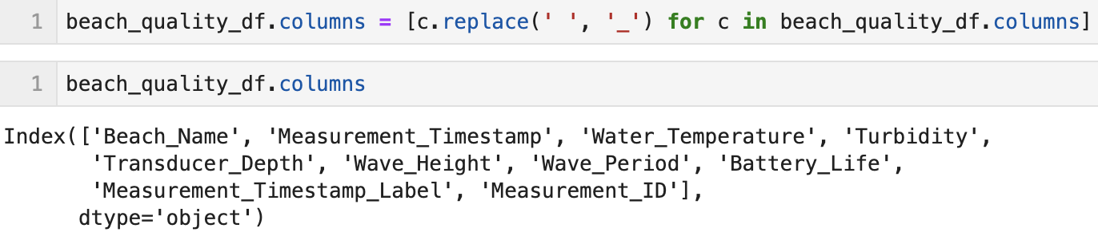

Slide 16
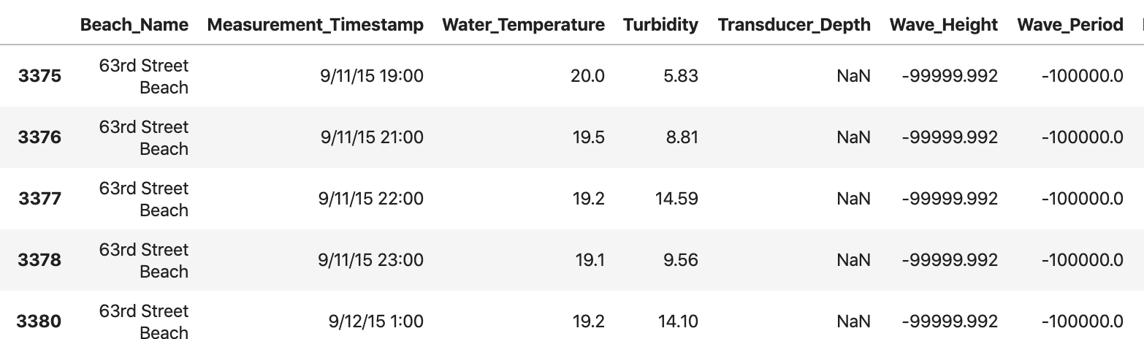

Slide 17
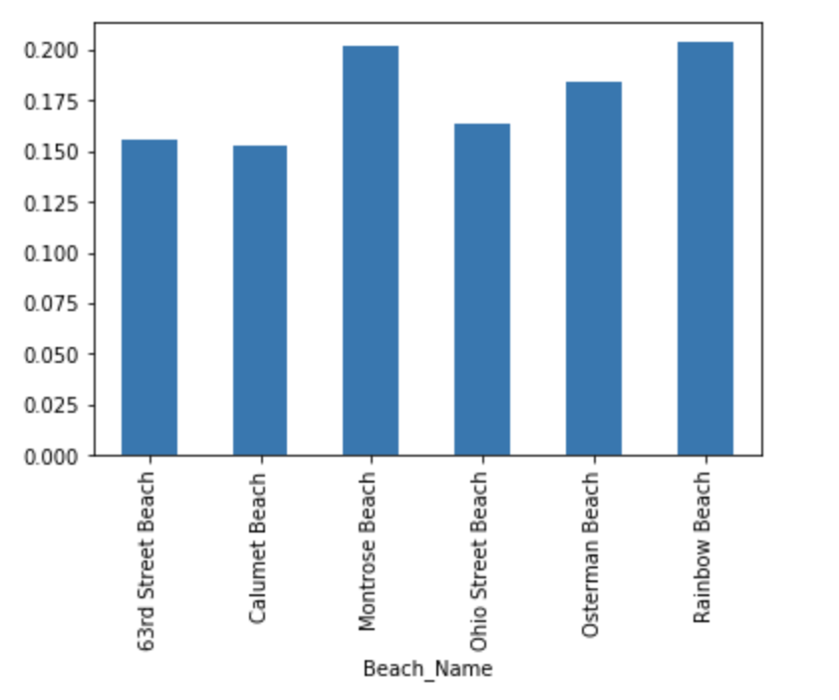

Slide 18
Which beach has the most E. Coli?

Slide 19
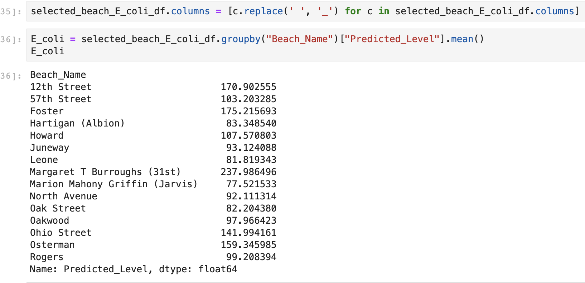

Slide 20
